Slide 1
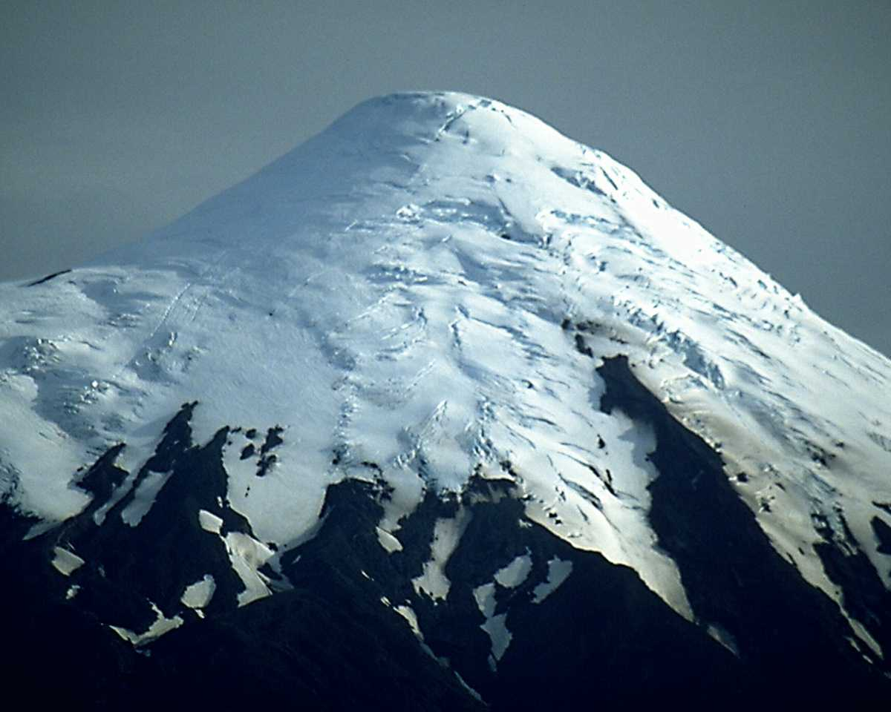

Foundation – Assessment Process
Copyright Berteig Consulting Inc. www.berteigconsulting.com

Slide 2
Foundation – Assessment Process
Agenda
Session Objective
Gap Analysis
SWOT Analysis
Plus Delta
Next Steps
Reflection
Copyright Berteig Consulting Inc. www.berteigconsulting.com

Slide 3
Foundation – Assessment Process
Session Objectives
This is the first of many processes to better understand your reality
This session will begin the assessment process by encouraging you to:
  Reflect
  Learn
  Plan
Copyright Berteig Consulting Inc. www.berteigconsulting.com

Slide 4
Foundation – Assessment Process
The “Gap” Analysis
  The ‘Gap” Anlaysis’
  You will come to better understand your:
    Current situation
    Desired situation
    Next Steps
Copyright Berteig Consulting Inc. www.berteigconsulting.com

Slide 5
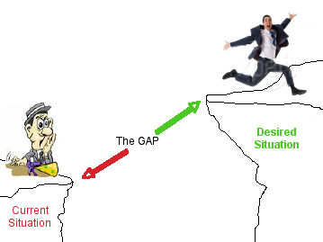
Foundation – Assessment Process
The “Gap” Analysis
Copyright Berteig Consulting Inc. www.berteigconsulting.com

Slide 6
Foundation – Assessment Process
The “Gap” Analysis
Next Steps
Copyright Berteig Consulting Inc. www.berteigconsulting.com

Slide 7

Foundation – Assessment Process
”SWOT” Analysis
Copyright Berteig Consulting Inc. www.berteigconsulting.com

Slide 8
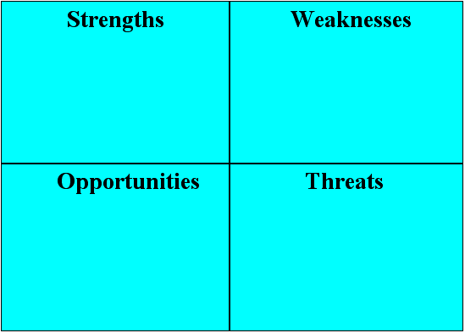
Foundation – Assessment Process
”SWOT” Analysis
Copyright Berteig Consulting Inc. www.berteigconsulting.com

Slide 9
Foundation – Assessment Process
”SWOT” Analysis
Internal to the Individual or Team
Copyright Berteig Consulting Inc. www.berteigconsulting.com

Slide 10
Foundation – Assessment Process
”SWOT” Analysis
External to the Individual or Team
External to the Individual or Team
Copyright Berteig Consulting Inc. www.berteigconsulting.com

Slide 11

Foundation – Assessment Process
”SWOT” Analysis
Copyright Berteig Consulting Inc. www.berteigconsulting.com

Slide 12

Foundation – Assessment Process
”SWOT” Analysis
Copyright Berteig Consulting Inc. www.berteigconsulting.com

Slide 13
Foundation – Assessment Process
”Gap” Analysis
  Team Project
  List your team strengths
  List your team weaknesses
  Discussion
Copyright Berteig Consulting Inc. www.berteigconsulting.com

Slide 14
Foundation – Assessment Process
”Plus/Delta” Analysis
+
What do you do well?
What would you change?
Copyright Berteig Consulting Inc. www.berteigconsulting.com

Slide 15
Foundation – Assessment Process
”Plus/Delta” Analysis
  Team Project
  List what your team does well
  List what your team could change
  Discussion
Copyright Berteig Consulting Inc. www.berteigconsulting.com

Slide 16
Foundation – Assessment Process
Next Steps
  Let's begin to list what you think the next steps may be?
  We can use post-it notes or a flipchart
  We will now move on to a much deeper and specific analysis of your situation
Copyright Berteig Consulting Inc. www.berteigconsulting.com

Slide 17
Foundation – Assessment Process
Reflection
  What do you think will be your greatest challenge as you consider and apply these three analysis forms?
Copyright Berteig Consulting Inc. www.berteigconsulting.com

